Slide 1

NurtureAI: Adult Behavioral Risk Analysis
Machine Learning-Based Caregiving Risk Prediction Using BRFSS 2013 Dataset
K-Means Clustering + Random Forest Classification | May 2026

Slide 2
Problem & Objective
The Challenge
Our Objective
Our Approach
Caregiving environments vary dramatically based on adult behavioral patterns. Identifying high-risk households early remains difficult without comprehensive data.
Segment adults into distinct behavioral risk groups and predict risk categories using minimal onboarding inputs for faster deployment.
Clustering: Identify natural behavioral patterns
Classification: Predict risk for new users instantly

Slide 3

Dataset — BRFSS 2013
Dataset Overview
Key Feature Categories
490,000+ survey responses
12 carefully selected features from 330+ total variables
Focus on health, lifestyle, and socioeconomic factors
Health: General, Physical, Mental wellness
Lifestyle: Sleep, Exercise, Smoking, Alcohol consumption
Socioeconomic: Income level, Marital status
Target: Healthy · Moderate Risk · High Risk classification

Slide 4




Data Preprocessing
Data Cleaning
Encoding
Handle missing values and special codes
Convert categorical variables to numeric format
Normalization
Validation
Scale values for consistent clustering
Drop incomplete or invalid rows
Result: ~191,000 clean, fully numeric records ready for analysis

Slide 5
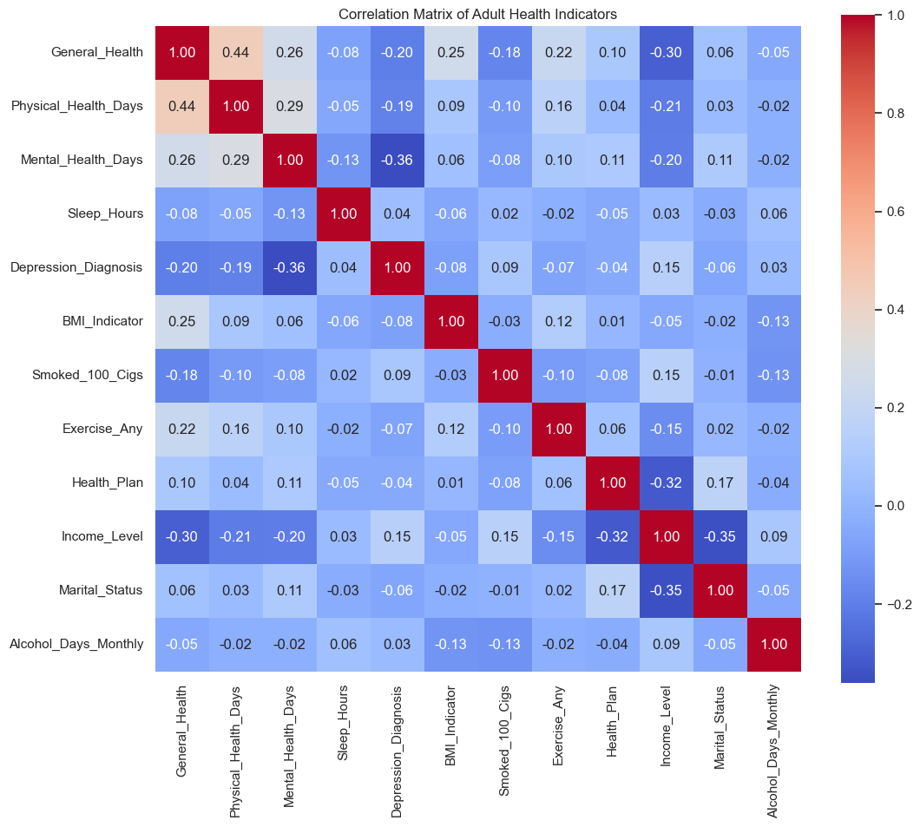
Correlation Matrix
Insights
General_Health and Physical_Health_Days (0.44), confirming that self-rated health perception is closely tied to frequency of physical illness.
Mental_Health_Days and Depression_Diagnosis (-0.36), validating that clinically diagnosed depression manifests in reported poor mental health days.
Income_Level and Marital_Status (-0.35), suggesting that household structure and financial stability are linked factors in caregiving capacity.
Income_Level and General_Health (-0.30), indicating that lower income brackets tend to report poorer overall health.

Slide 6
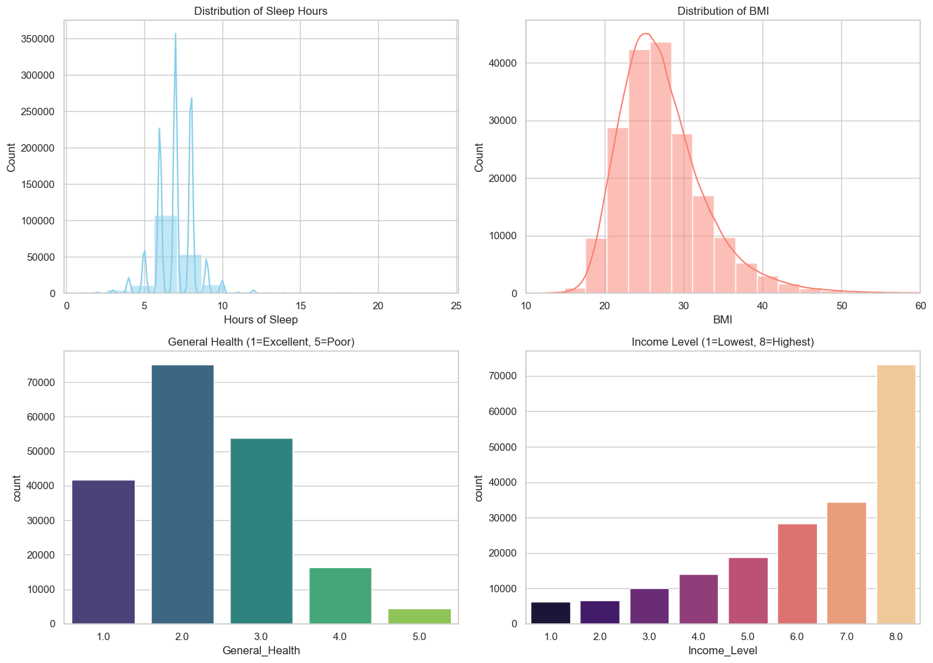
Exploratory Data Analysis — Key Insights
Sleep Duration
Most adults report 7–8 hours of sleep per night, aligning with recommended guidelines
BMI Distribution
Data skewed toward overweight and obese categories, reflecting population health trends
Income Impact
Lower income brackets show stronger correlation with mental health challenges
Sleep & Depression
Irregular sleep patterns strongly associated with reported depression symptoms

Slide 7
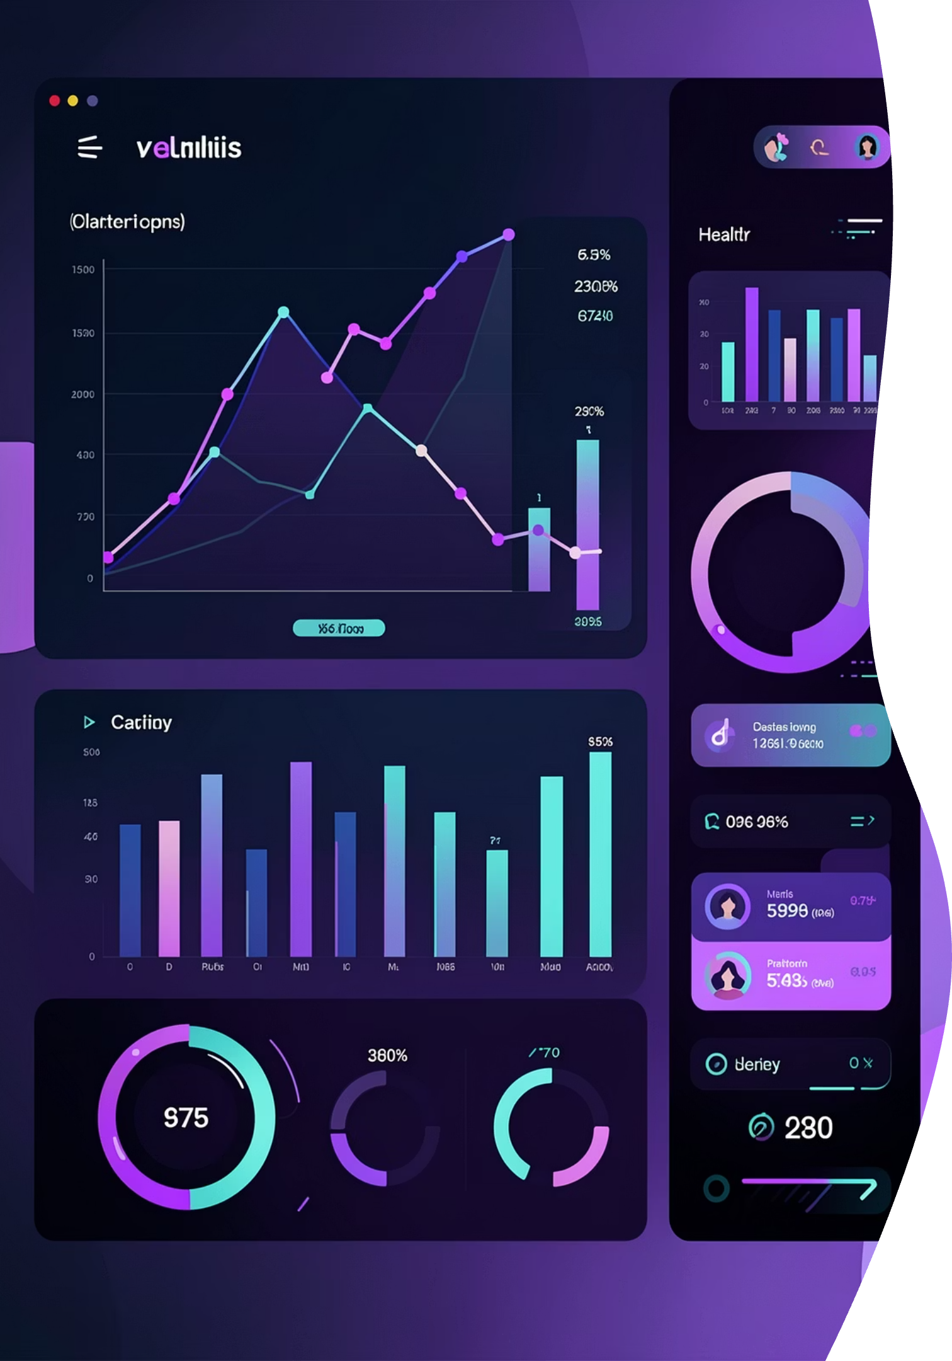
Feature Engineering — Risk Scores
Transformed 12 features into 3 meaningful composite scores, each scaled to [0,1] range.
Mental Stress Score
Lifestyle Risk Score
Combines mental health status, depression indicators, and sleep quality to quantify psychological burden.
Integrates exercise frequency, smoking status, and alcohol consumption patterns for behavioral assessment.
Physical Risk Score
Merges physical health status, BMI classification, and general wellness for physical health evaluation.

Slide 8
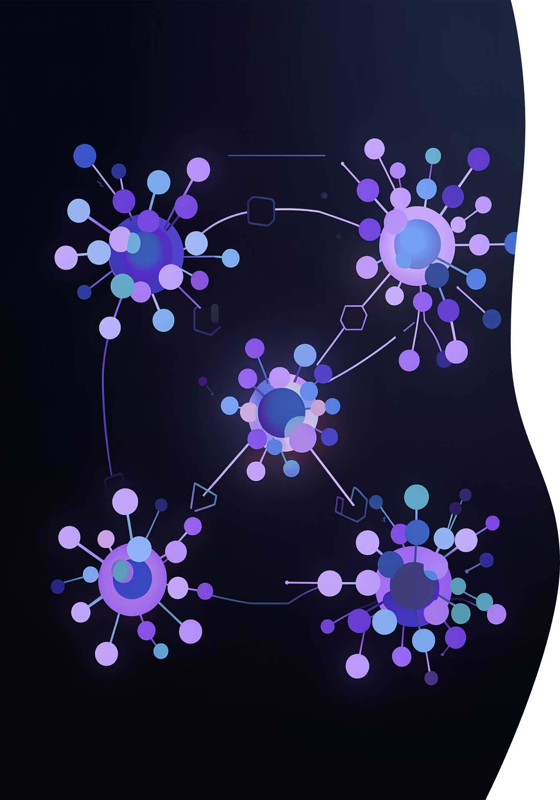
Unsupervised Learning — Clustering
Algorithms Tested
K-Means (K=3)
Hierarchical
Selected for best balance of performance and interpretability
Considered but slower and less scalable
DBSCAN
Evaluated for density-based clustering
Result: K-Means selected for best combination of performance metrics and interpretability

Slide 9
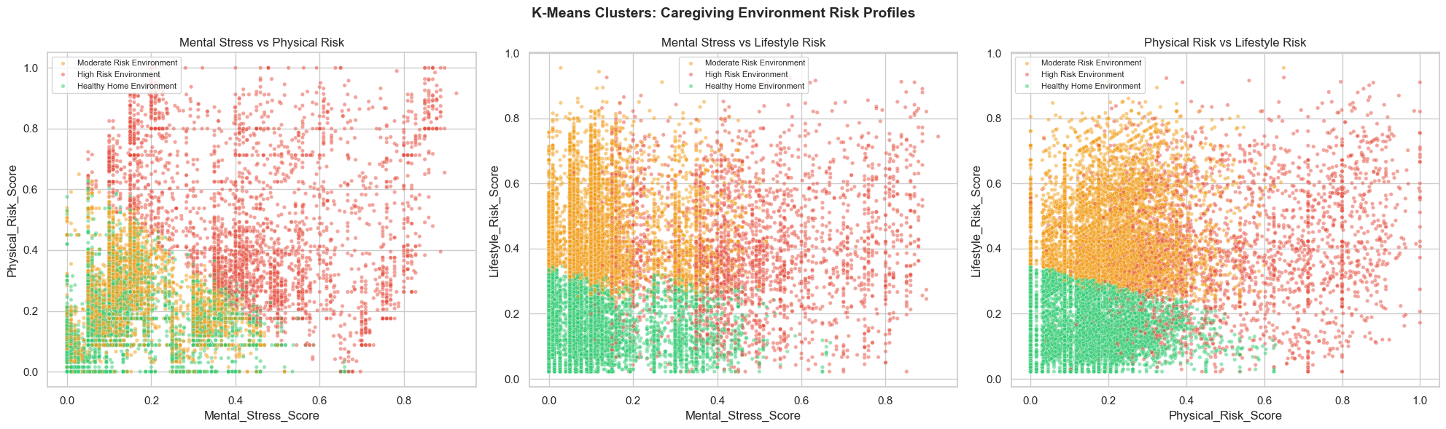

Slide 10
Risk Segments
🟢 Healthy Environment
🟡 Moderate Risk
🔴 High Risk
Good sleep quality, regular exercise, stable income levels, positive mental health indicators
Some lifestyle or health issues present, requires monitoring and support interventions
Poor health indicators, low income, unhealthy habits, immediate caregiving attention needed

Slide 11
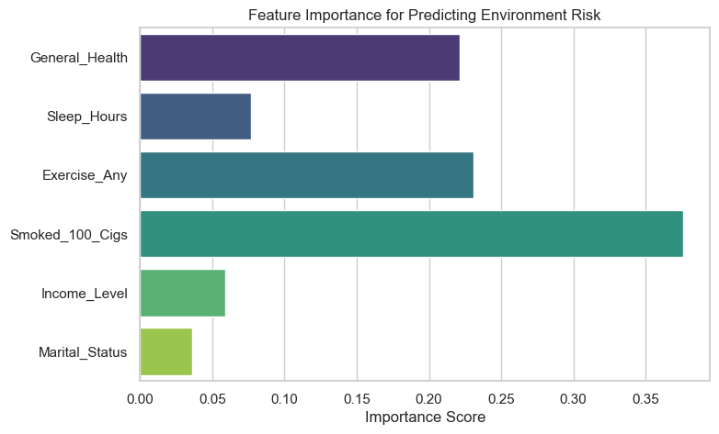

Slide 12
Supervised Learning — Random Forest
Model Purpose
Input Features (6)
Predict risk category instantly for new users based on minimal input data
General Health
Why Random Forest
Self-reported overall wellness
High accuracy across all risk categories
Handles complex non-linear patterns
Fast prediction for real-time deployment
Provides feature importance insights
Sleep Hours
Daily sleep duration
Exercise
Physical activity frequency
Smoking
Tobacco use status
Income
Household income bracket
Marital Status
Relationship status

Slide 13

Final Pipeline & Deployment
Dataset
BRFSS 2013 raw survey data
Preprocess
Clean, encode, normalize values
Feature Engineering
Create composite risk scores
Clustering
Identify behavioral patterns
Classification
Train Random Forest model
Deployment
Real-time prediction system
Model Output
Deployment Details
Risk category label (Healthy, Moderate, High)
Confidence scores for predictions
Personalized recommendations
Model serialized as .pkl file and integrated into web application for real-time risk prediction during user onboarding.

